Slide 1
Business Process Engineering
Week 03

Slide 2
Business Process Engineering includes:
Business Process Management
Business Process Modeling
Business Process Architecture
Business Process Improvement

Slide 3
Business Process Management
The achievement of an organization’s objectives through the improvement, management and control of essential business processes.
Managing business processes is a huge challenge in most organizations. Many business owners assume that it is a huge expense or that it is only worth it for massive processes
Business process management (BPM) is also defined as an organizational discipline where a company takes a step back and looks at all of these processes in total and individually. It analyzes the current state and identifies areas of improvement to create a more efficient and effective organization.

Slide 4
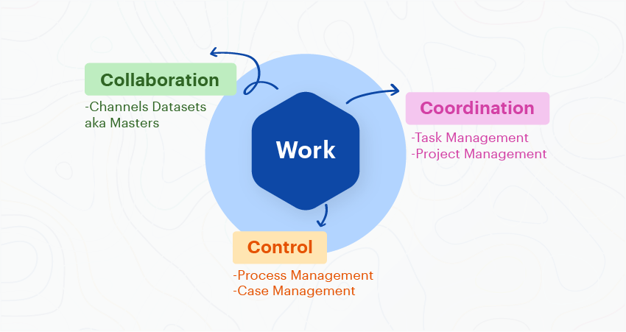
Business Process Management
Business process management (BPM) is an organizational discipline where a company takes a step back and looks at all of these processes in total and individually.
It analyzes the current state and identifies areas of improvement to create a more efficient and effective organization

Slide 5
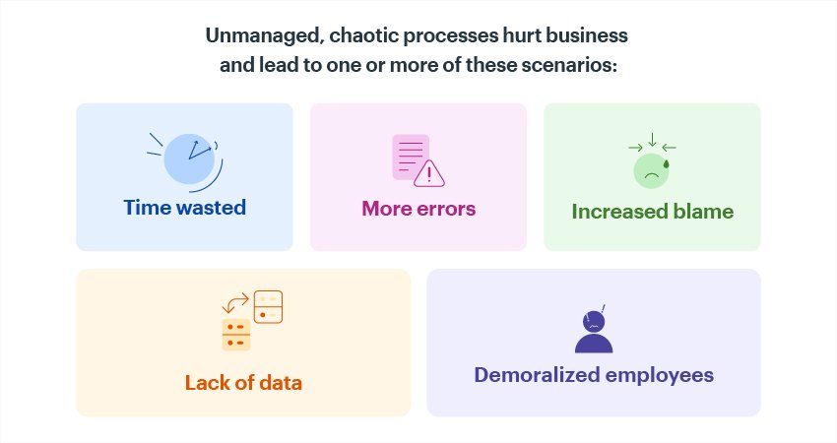
What is the Purpose of Business Process Management?

Slide 6
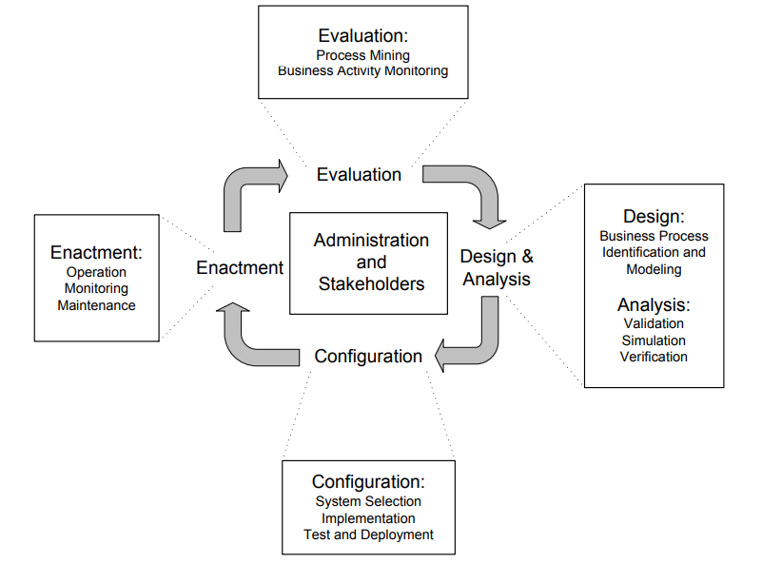
Business Process Lifecycle

Slide 7
Design and Analysis
The business process lifecycle is entered in the Design and Analysis phase, in which surveys on the business processes and their organizational and technical environment are conducted.
Based on these surveys, business processes are identified, reviewed, validated, and represented by business process models.

Slide 8
Configuration
Once the business process model is designed and verified, the business process needs to be implemented. There are different ways to do so. It can be implemented by a set of policies and procedures that the employees of the enterprise need to comply with.
The configuration of a business process management system might also involve transactional aspects. Transactions are a well-known concept from database technology for example, where a transaction manager guarantees that application programs run as transactions and obey the ACID principle: atomicitiy, consistency, isolation, and durability

Slide 9
Atomicity
Atomicity is a property that ensures that a task follows the all or nothing rule. In other words, the Process/ Task considers all transaction operations as one whole unit or atom.
For example, user A wants to withdraw $50 from his account and then transfer it to the account of user B. Each transaction (withdrawing $50 from account A and transferring $50 to account B) is counted as separate. If the first transaction (withdrawing $50) fails because (say) the server crashes during the transaction, user A cannot transfer the money to user B.

Slide 10
Consistency
Consistency is a property ensuring that only valid data following all rules and constraints is written in the Process/Task.
For example, if user A wants to withdraw $1,000 from his account, but only has a balance of $500, consistency will prevent him from withdrawing money and the transaction will be aborted

Slide 11
Isolation
Isolation is a property that guarantees the individuality of each transaction, and prevents them from being affected from other transactions. It ensures that transactions are securely and independently processed at the same time without interference, but it does not ensure the order of transactions.
For example, user A withdraws $100 and user B withdraws $250 from user Z’s account, which has a balance of $1,000. Since both A and B draw from Z’s account, one of the users is required to wait until the other user transaction is completed, avoiding inconsistent data.
If B is required to wait, then B must wait until A’s transaction is completed, and Z’s account balance changes to $900. Now, B can withdraw $250 from this $900 balance

Slide 12
Durability
Durability is a property that enforces completed transactions, guaranteeing that once each one of them has been committed, it will remain in the system even in case of subsequent failures.
If a transaction is successful, all changes generated by it are stored permanently.
In the above example, user B may withdraw $100 only after user A’s transaction is completed.

Slide 13
Enactment
During business process enactment, valuable execution data is gathered, typically in some form of log file. These log files consist of ordered sets of log entries, indicating events that have occurred during business processes. Start of activity and end of activity is typical information stored in execution logs.

Slide 14
Evaluation
Execution logs are evaluated using business activity monitoring and process mining techniques. These techniques aim at identifying the quality of business process models and the adequacy of the execution environment.

Slide 15
The Value of Information
The value of Information is directly linked to how it helps decision makers achieve their organization’s goals.

Slide 16
Element of a Business Process
People: Human Resource (level, ranks, responsibilities, information)
Procedures:
Strategies, policies, methods, and rules.

Slide 17
General Flow of a Process
Management Decisions
(Environment)
Data
Input
Process
Output
Information
Control
Feedback

Slide 18
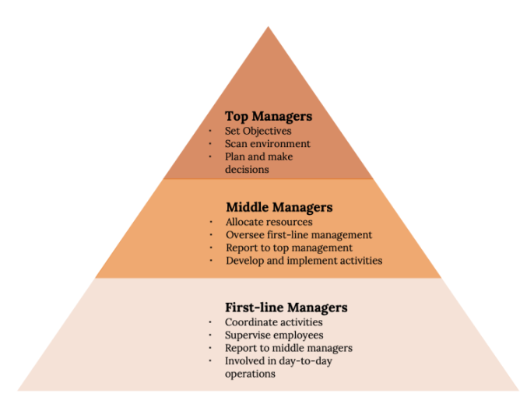
Level of Management

Slide 19
Systems Applications and Information Flow in the Organization
Decisions
Management Levels
Information Systems
Unstructured
Senior Management
ESS
Strategic
DSS
Knowledge and Data Worker
GIS, CAD/CAM, OAS
Tactical
Middle
Management
MIS
Lower
Management
TPS
Technical
(Operational)
Buy
Make
Sell
Keep
Track
Functions
Structured

Slide 20
Data Characteristics
Data range refers to the amount of data from which information is extracted&
Time span refers to how long a period of time the data covers.
Level of detail is the degree to which the information generated is specific.
Internally or externally sourced.

Slide 21
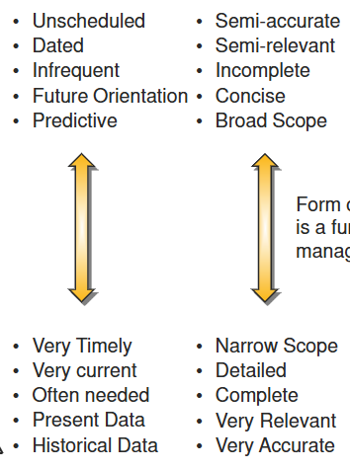
Information Need

Slide 22
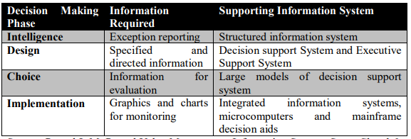
Decision Making Phase

